Slide 1

Creating Projects using Microsoft Visual Studio 2022
CTEC1332
Software Engineering Practices
2023 Fall
Version 2.2: Covers Windows 10 PCs in L117
Last updated: 2023.09.02

Slide 2
Part 1: Basic operation
Visual Studio 2022 Guide

Slide 3
Starting Visual Studio 2022
Both Visual Studio 2022 and Visual Studio 2019 are installed on PCs in L117.
(There is a separate guide for Visual Studio 2019.)
Otherwise, you can download and install the latest version on your PC (or Mac)…

Slide 4
Starting Visual Studio 2022
Download and install Visual Studio 2022 Community edition:
https://visualstudio.microsoft.com/downloads/
This is the preferred option, because it installs Visual Studio on your PC (or Mac).

Slide 5
Starting Visual Studio 2022
The following slides refer to using a native installation of Visual Studio on a Windows 10 PC.

Slide 6
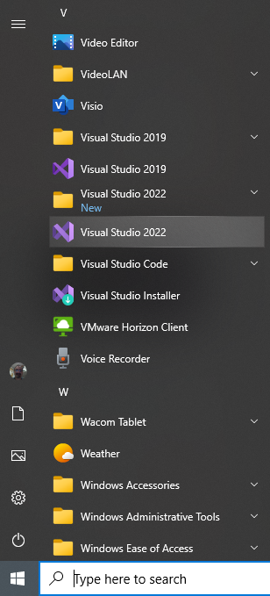
Starting Visual Studio 2022
From the Windows 10 Start Menu go to the "V" section and start Visual Studio 2022 (it has a purple icon).

Slide 7

The “splash screen” is shown while Visual Studio loads … it may take several seconds.

Slide 8
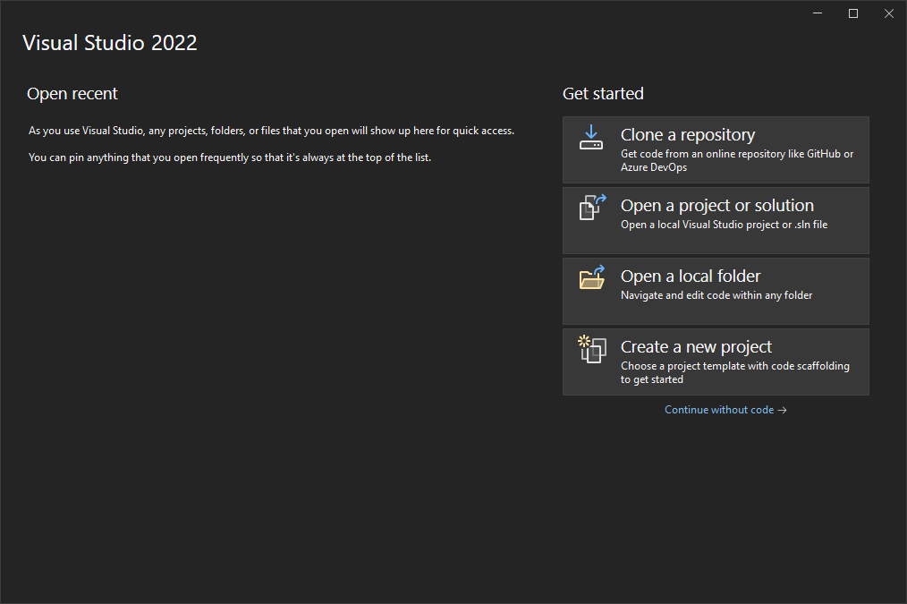
Visual Studio 2022
This is the “Dark” colour theme (the default.) It can be changed…

Slide 9
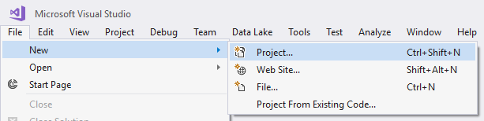
Create A New Project (Alternate Ways)
From the File menu, select New, then Project…
You can also press Ctrl+Shift+N instead
1
2
3
This is the “Blue” colour theme on Mike Boldin's PC.

Slide 10
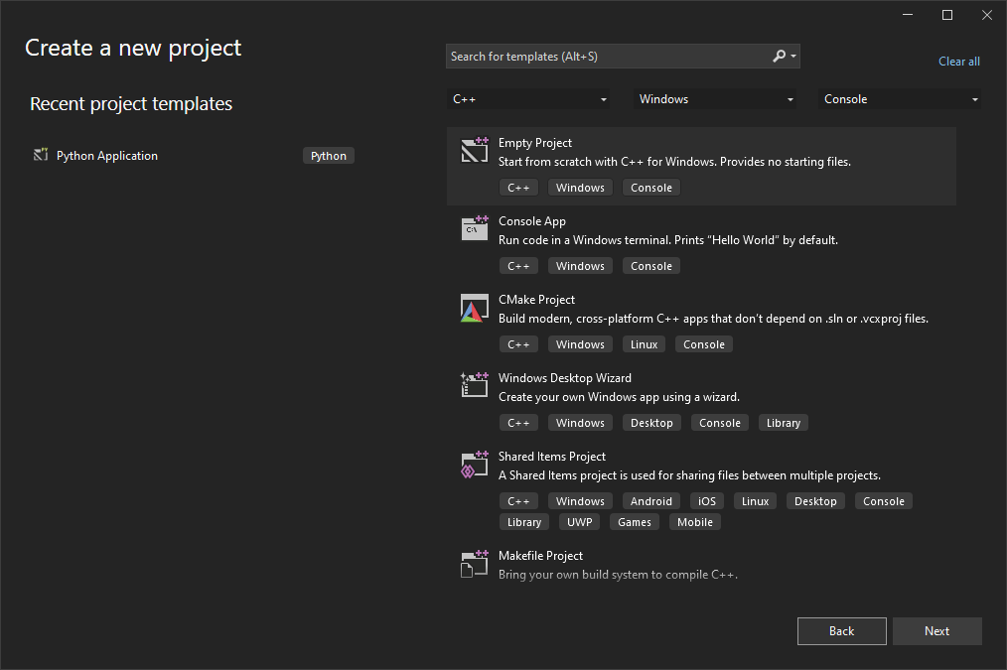
The “Create a new project” dialog box appears
For every program we do in this course, the Language is C++, the platform is
Windows, the project type is Console, and the project template is Empty
1
2
3

Slide 11
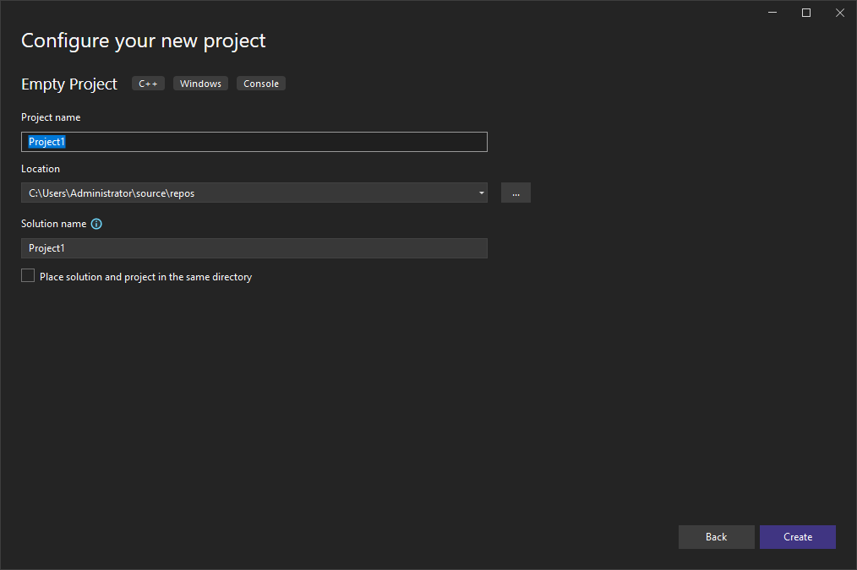
The “Configure your new project” dialog box appears
Every program we do in this course will have its own folder. You are
responsible for keeping track of your files!
2
1
3
4

Slide 12
Step 1. Choose the Project Location
Click on the “browse” button to pop up the “Project Location” dialog box. From here, choose or create a folder in which to store your projects.
Each project will have its own subfolder.
If you choose to save projects on drive C:, it may be faster, BUT you need to back up those folders!

Slide 13
Step 1. Choose the Project Location
I recommend the following (in order of preference):
  The "Storage" partition on the internal NVMe SSD (fastest option, but you need to manage your files);
  Your own USB SSD or HD (fast and private);
  Your “One Drive – NC” – if available (automatically copied to the Cloud);
  Your own USB flash drive (slowest option).

Slide 14
Step 1. Choose the Project Location
If you are working in L117, choose the "Storage" partition on the internal SSD (solid state disk) – E: drive.
When you are finished, make sure that you:
  Copy your files to your own USB and/or your One Drive NC, so that you have a copy;
  Delete your files from the SSD, so that others cannot copy your work!

Slide 15


Step 1. Project Location Examples
In the example on the left, I have chosen C:\2020F\ctec1332\src as the main folder for all my Visual Studio projects.
In the example on the right, I have chosen my OneDrive, and created a “2020F” folder, then a “ctec1332” subfolder, which will be the main folder for projects.

Slide 16
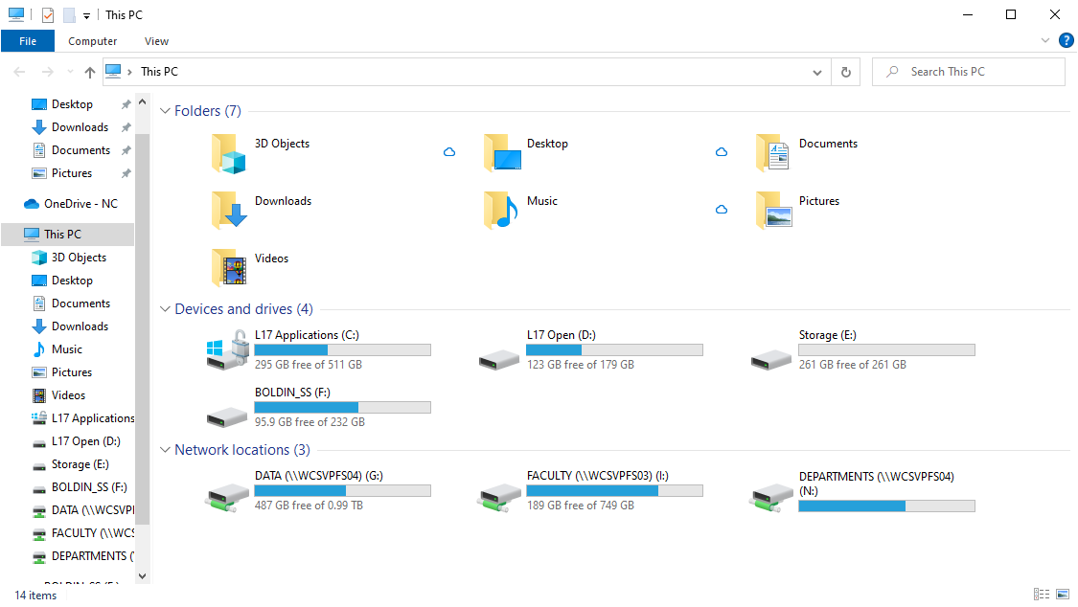
Step 1. Suggested Project Location in L17
In this example, using Windows Explorer/File Explorer, I have chosen drive E: …

Slide 17
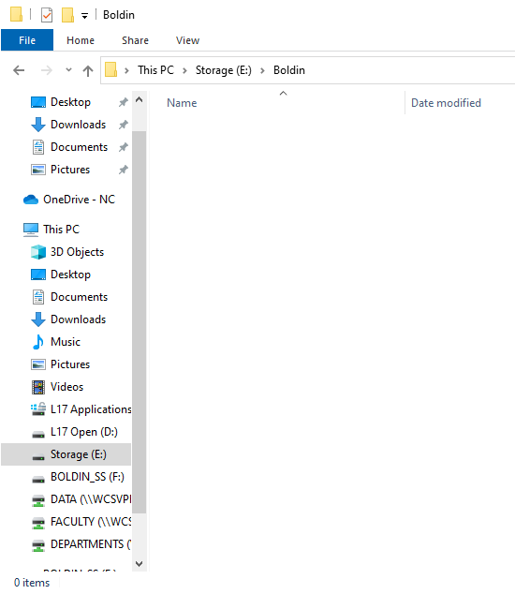
Step 1. Suggested Project Location in L17
On drive drive E:, I create my own folder … in this folder, I will create Visual Studio project sub-folders

Slide 18
Step 2. Give the Project a Name
The name will be used for both the project folder and the executable.
  For example, for the C++ Console app above, if I don't change the name, the project folder will be Project1 and the executable will be written to Project1\x64\Debug\Project1.exe

Slide 19
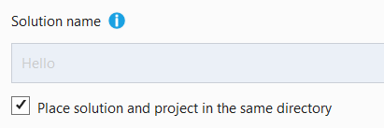
Step 3. One Directory Only
Visual Studio allows you to create multiple Projects within a single Solution.
In this course, we will have exactly one Project per Solution, so to simplify things, only one folder is needed.

Slide 20
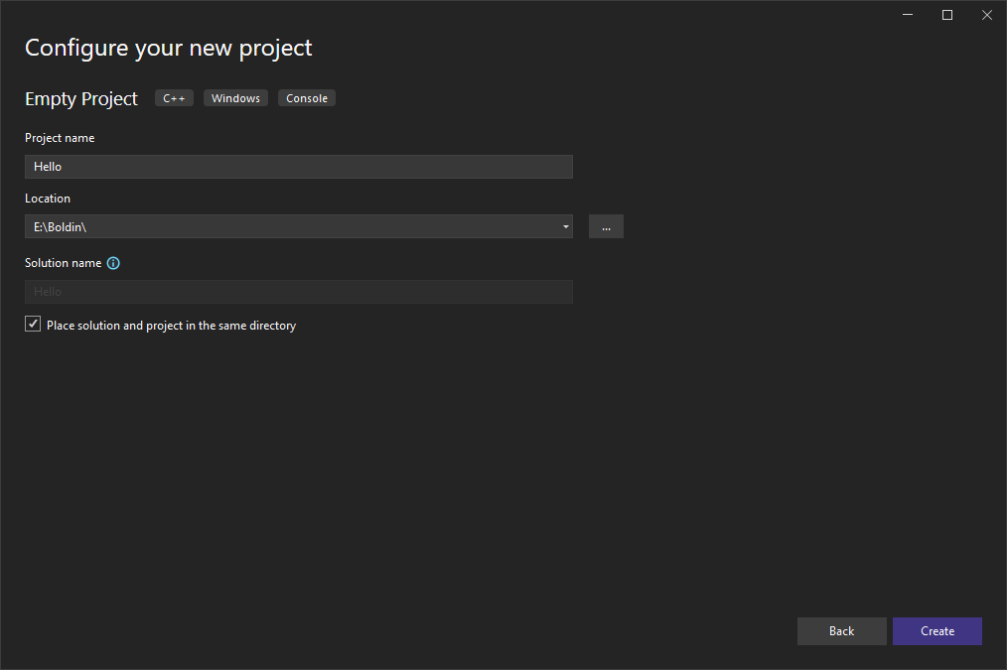
Step 4. Create the Project

Slide 21
Step 4. Project Example Details…
Project folder location
will be
E:\Boldin\Hello
Executable will be
called Hello.exe
I will add at least one
.c file in this folder
(C is a subset of C++)

Slide 22
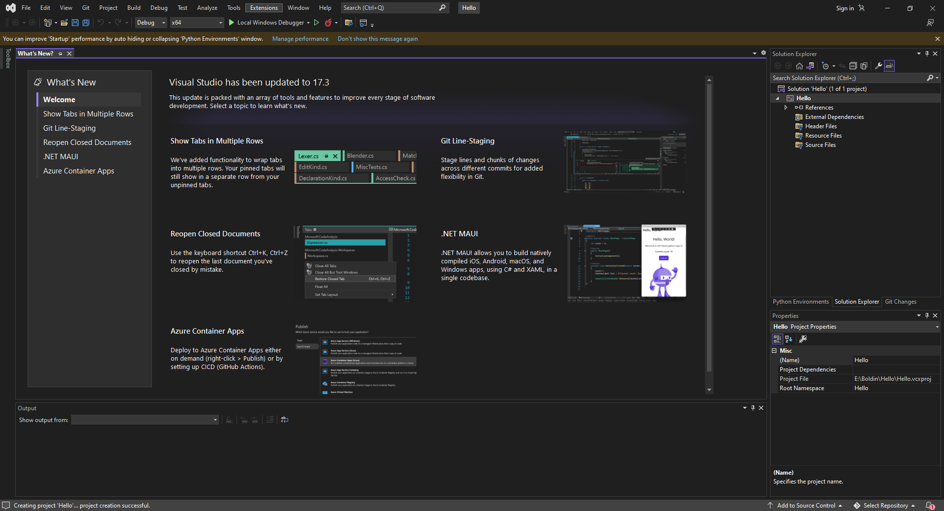
New Project Created
Type in code here
Visual Studio creates an “Empty” project, meaning that you have to add a
source code file. (Note: you can close the "What's New?" pane.)

Slide 23
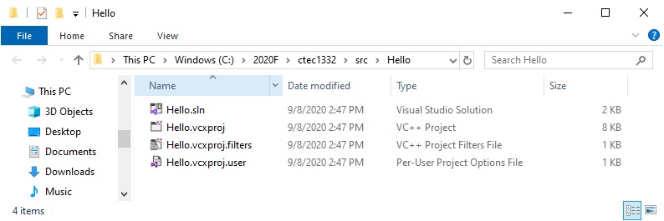
Empty Project Folder Example
There are four files and one hidden directory.
Copy a source code (.c) file here, using either File Explorer or
the Command Prompt.
A template .c file is always here:
http://technology.niagaracollege.ca/courses/ctec1332/template.c

Slide 24
Adding A C File to Your Project
You have several choices here:
  Download template.c from the course web site (or Blackboard) to your new project folder;
  Download a .c file Blackboard as part of a lab to your new project folder;

Slide 25
Adding A C File to Your Project
(continued)
  Download a .zip file from Blackboard as part of a lab. Extract the src folder from the .zip file, and copy one of the .c files to your new project folder;
  Copy a .c file, from a project that you have previously worked on, to your new project folder.

Slide 26
Adding A C File to Your Project
(continued)
  Type in C code directly from the lab Word document.
For choices 1, 2, 3, and 4, use Method 1 to add the existing .c file;
For choice 5, use Method 2 to create a new .c file.

Slide 27
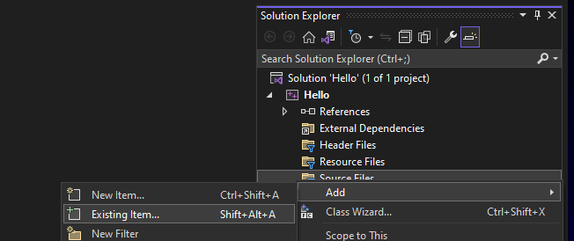
[Method 1] Adding an existing C file
In CTEC1332, you will do this, when a lab provides a .c file or you are asked to start from the template!
Right click on the "Source Files" category in the Solution Explorer.
Select "Add Existing Item…".
Alternately, press the [Shift]+[Alt]+[A] key combination.

Slide 28
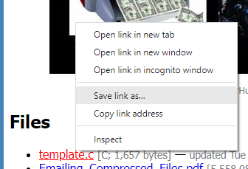
Downloading the Template
A template .c file is always here:
http://technology.niagaracollege.ca/courses/ctec1332/template.c
To download, right click and choose "Save link as…". You can then
download and save the template.c file directly into your project folder
(and even rename it at the same time.)

Slide 29
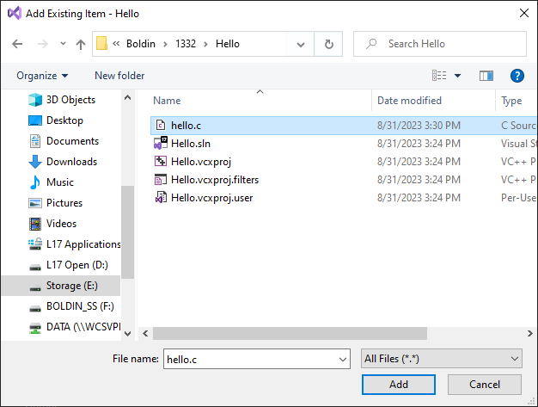
[Method 1] Adding an existing C file
Make sure that you browse to the correct project folder -- the one that you are working on! This way, you add the correct C file to the project.

Slide 30
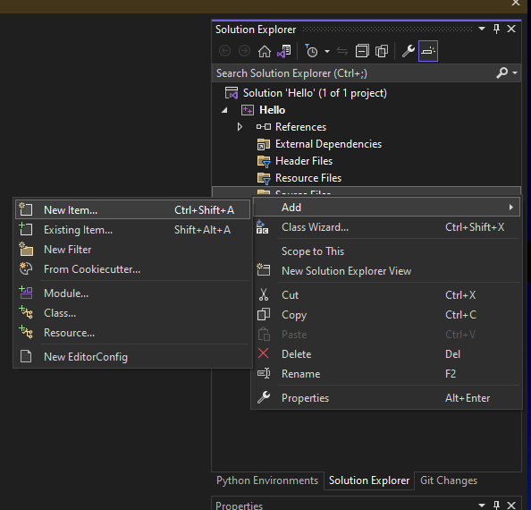
[Method 2] Adding a new C file
In CTEC1332, you will do this, when a lab requires you to type in C code from scratch!
Another way is to Add a New Source File to the project.
Right click on the "Source Files" category in the Solution Explorer.

Slide 31
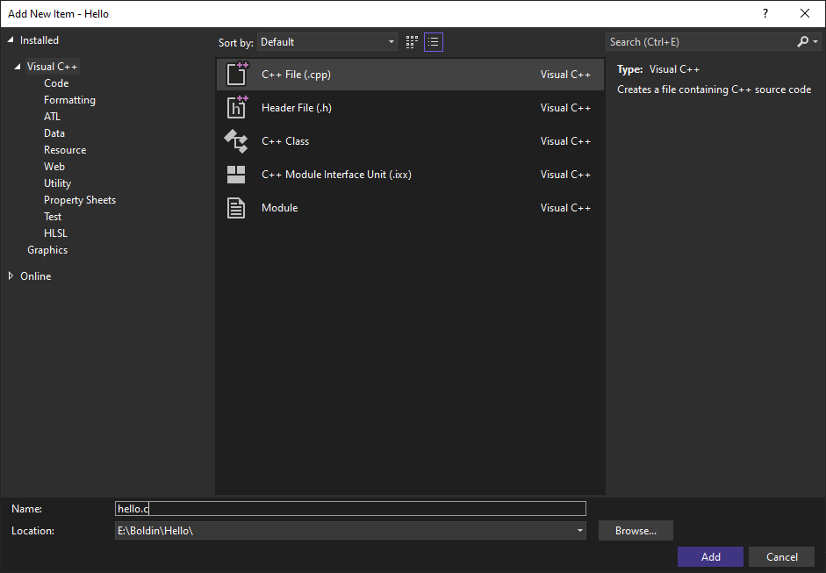
[Method 2] Adding a new C file
1. Choose a C++ File (.cpp extension is the default)
One way is to Add a New Source File to the project.
Right click on the "Source Files" category in the Solution Explorer.
Note: We will not normally do this, because it requires you to type in C code from scratch!
3. Click Add to create the empty file and add it to the project.
2. Erase the "pp", leaving only .c as the extension. (The file will be automatically saved in the project folder.)
Type in code here

Slide 32
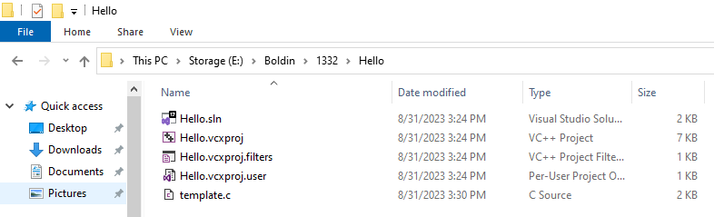
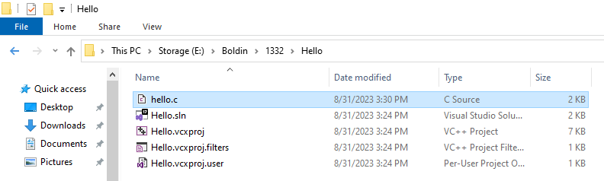
Project Folder Example with C File
Here I downloaded template.c to my project folder. I can right click and
Rename it after the fact:

Slide 33
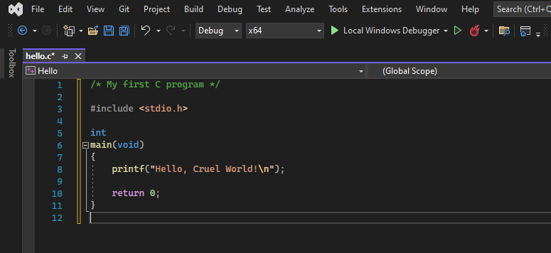
Editing and Building
Type in code here
You type in C code into the text editor pane for each .c (or .h) file in the project.
The default build type is x64 Debug.
Click on "Local Windows Debugger" to build and run the code.

Slide 34
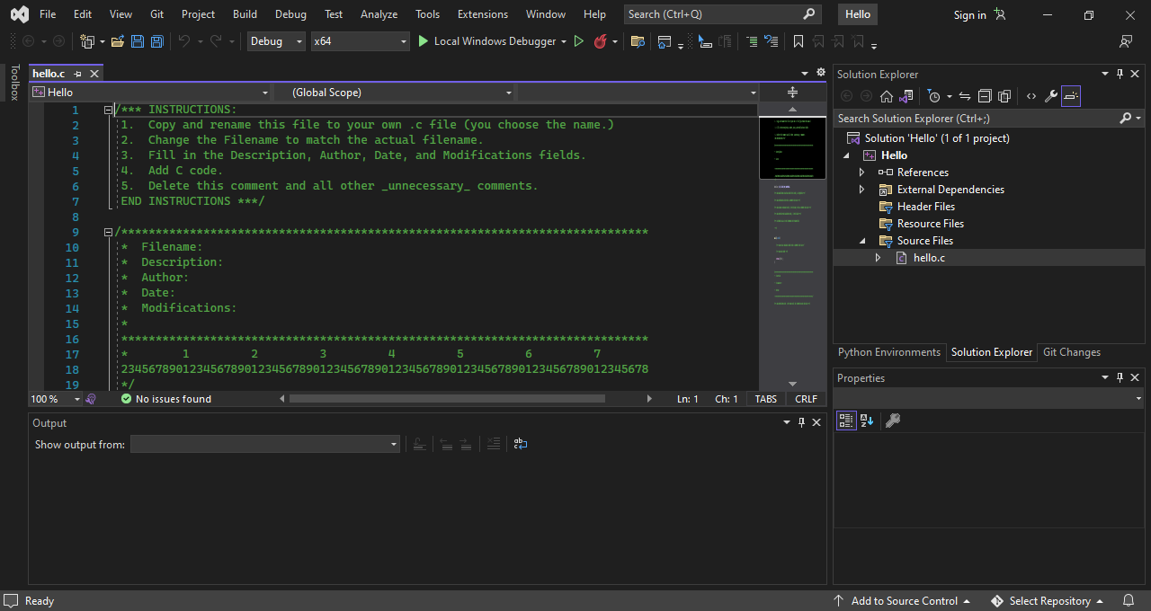
Editing Your C File
Now that your C file is added to the project, click on the filename to open it in the Visual Studio text editor pane.

Slide 35
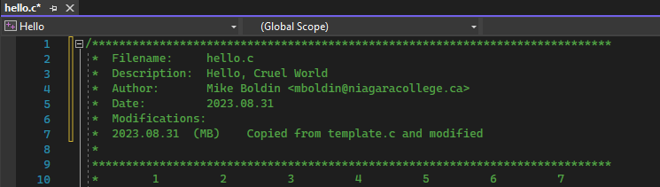
Template: Comment Block
If you are using template.c, follow the instructions at the top of the file. (The last instruction says "delete these instructions"…)
Fill in the comment block with the following information:
  Filename: the name of the C file
  Description: one sentence explaining what the program is or what the program does
  Author: your name and email address
  Date: when you started editing the file
  Modifications: a list of when you edited the file, and a summary of what you did each time

Slide 36
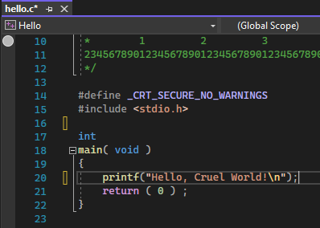
Template: Code
Inside the main function, type in code that makes up the program.
My example is very simple, so it is only one line of code!
Visual Studio will help you with syntax colouring (and other things.)

Slide 37
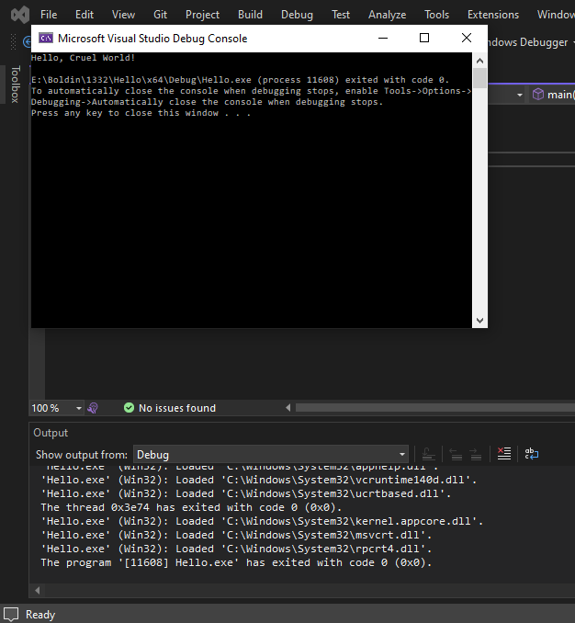
Running the Program
Click on "Local Windows Debugger" or press [F5] to run the program.
If it works, you will see a Debug Console window, containing the program output.
(If you made a mistake, you will see error messages in the Output pane at the bottom.)

Slide 38
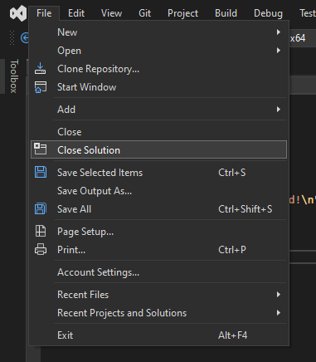
When you are done
When you are done coding, from the File menu, select Close Solution to make sure that all project files are saved.

Slide 39
Part 2: Managing Your Files
Visual Studio 2022 Guide

Slide 40
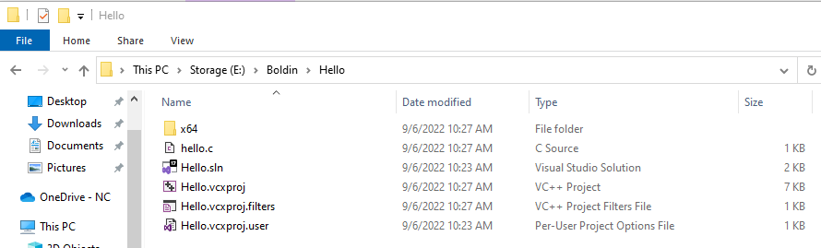
The resulting files and folders
Using File Explorer to view the project folder, I can see that there are five (5) files -- four project files and one source file, and an "x64" folder, in which build files are written.

Slide 41
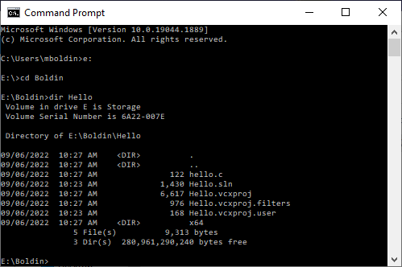
The resulting files and folders
I can use the Command Prompt to view the same files and folder.

Slide 42
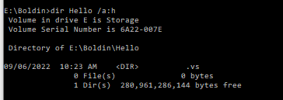
The resulting files and folders
There is also a second, hidden folder, which stores various Visual Studio settings.
If this folder is removed or not copied, you basically need to re-create a project from scratch, and then copy the .c file to the new project.

Slide 43
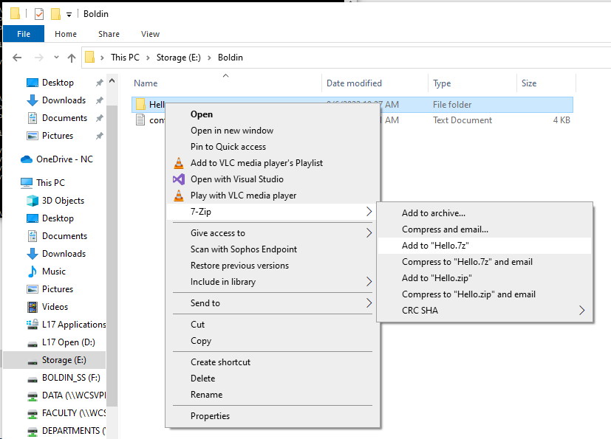
Backing up your work
An easy way to make a complete backup of a project is to zip the project folder.
7-Zip is installed in L117 and you can create both .zip and .7z files by right-clicking on a project folder.

Slide 44
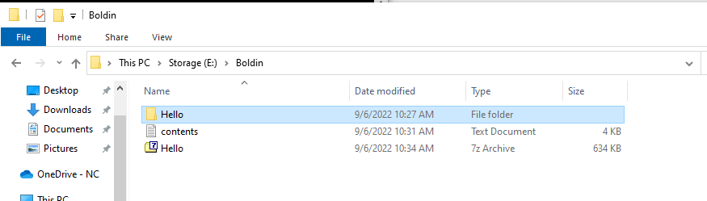
Backing up your work
Here, I created a 7z Archive of my project folder.
This is great for a complete backup, but you may not be able to email the file, because it contains the Application (.exe) file.
You can only keep the essential project files… to correct this now, I need to re-open the project in Visual Studio…

Slide 45
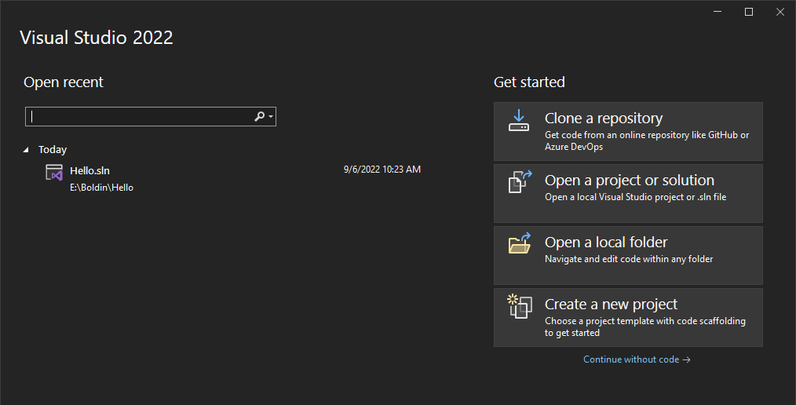
Re-opening a project
When you restart Visual Studio during a lab session (or on your own PC), it remembers recent projects (on the left).
But you can also choose "Open a project or solution" (on the right).

Slide 46
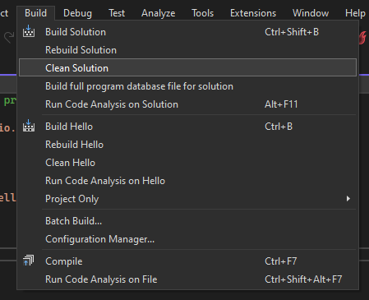
Cleaning a project
From the Build menu,
select "Clean Solution" to remove unnecessary build files.
You can re-build the next time you use Visual Studio.
This will allow you to make smaller and more portable backups.

Slide 47
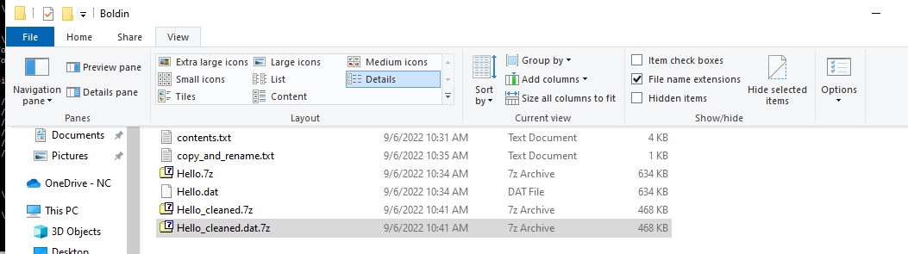
Backing up your work
Here I created a second 7z Archive of the cleaned project. It is smaller.
From the View menu in File Explorer, I can select File name extensions to view (and rename) the extensions.
(Hidden items is also here to expose hidden files and folders.)

Slide 48
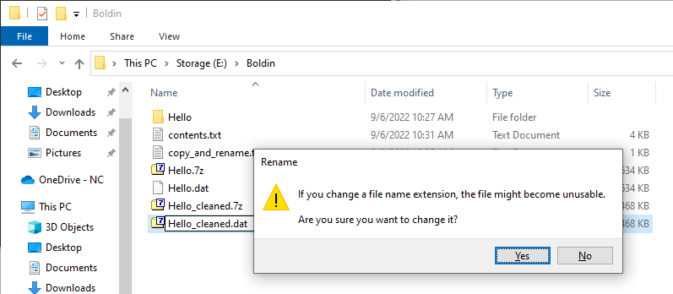
Email your backups
Email is a good backup tool, because it creates multiple copies of your attached files (Inbox, Sent Items, one to each recipient!)
However, some email services will reject zip attachments. Instead, I can rename a .zip (or .7z) file with, say, a .dat extension.

Slide 49
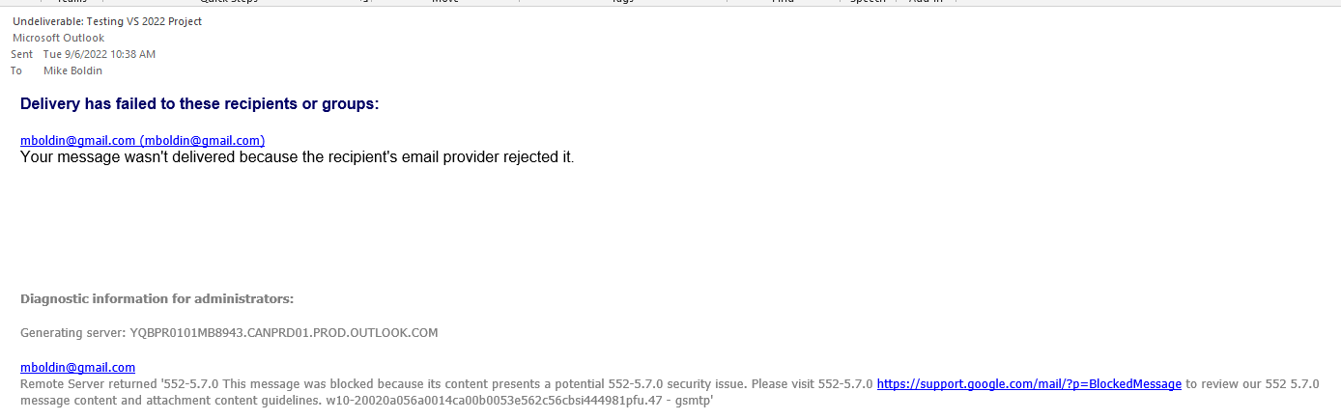
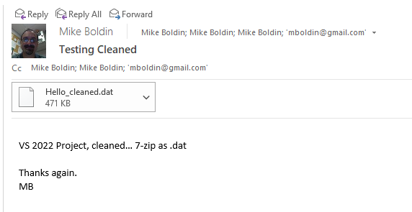
Email your backups
Here, I tried to email the un-cleaned .7z file. It failed…
Here I successfully emailed the cleaned .7z file! Four backups were created!

Slide 50
You can never have too many backups!
The “3-2-1 backup rule”:
  Have at least three copies of your data
  Store the copies on two different media
  Keep one backup copy offsite
https://www.veeam.com/blog/how-to-follow-the-3-2-1-backup-rule-with-veeam-backup-replication.html Retrieved on September 9, 2017

Slide 51
The “3-2-1 backup rule” gives you choices:
Have at least three copies of your data
  Hard disks, flash drives, optical discs, tapes, cloud services, email addresses/services
Store the copies on two different media
  Hard disk, flash, optical, tape, cloud, email
Keep one backup copy offsite
  Different physical location, cloud, email
https://www.veeam.com/blog/how-to-follow-the-3-2-1-backup-rule-with-veeam-backup-replication.html Retrieved on September 9, 2017

Slide 52
Part 3: working with existing code
Visual Studio 2022 Guide

Slide 53
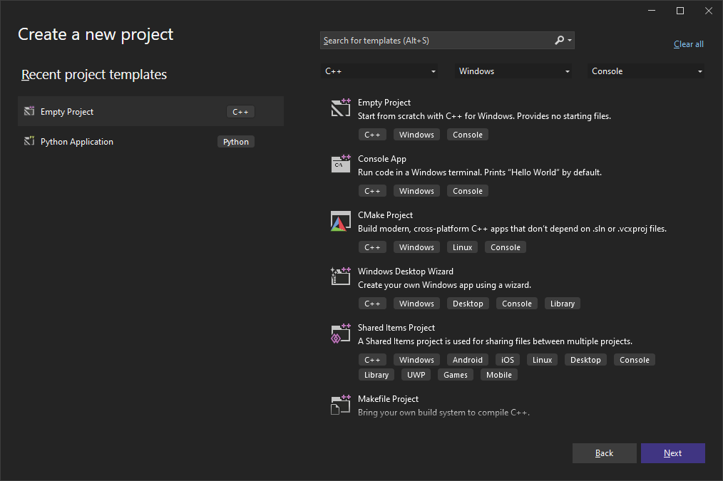
Using code from a previous project
When you create a second project in L117 or your own PC, Visual Studio remembers the project types you have already used.

Slide 54
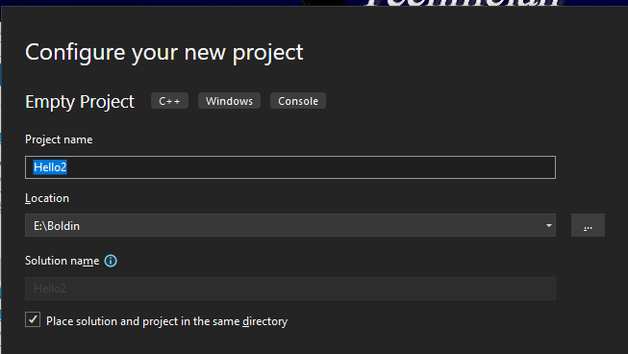
Using code from a previous project
In CTEC1332, this type of project will be used almost all of time!

Slide 55
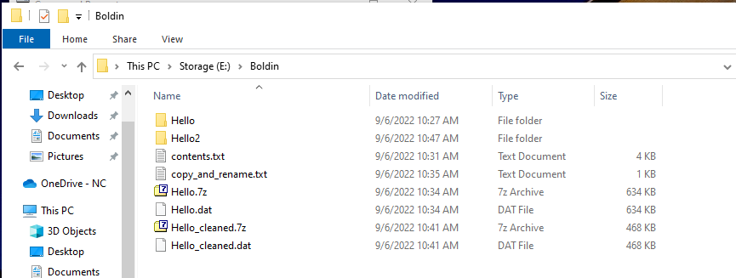
Using code from a previous project
I am about to copy code from my first project to my second project

Slide 56
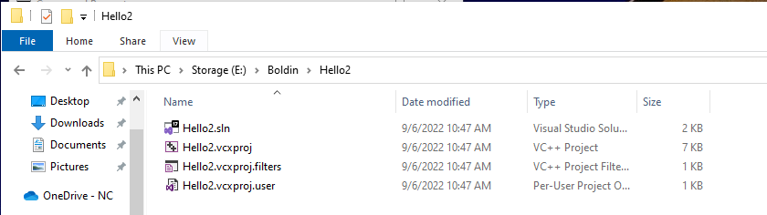
Using code from a previous project
Because we are using the Empty Project template, no .c file exists in the second, newer project.

Slide 57
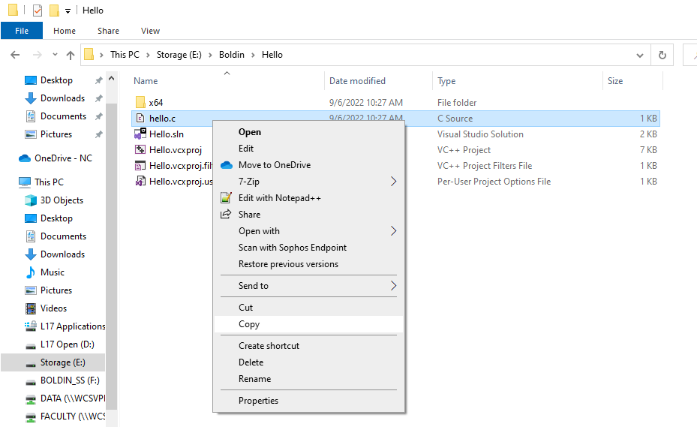
Using code from a previous project
First, go to the first, older project and copy the .c file by right-clicking on the filename.

Slide 58
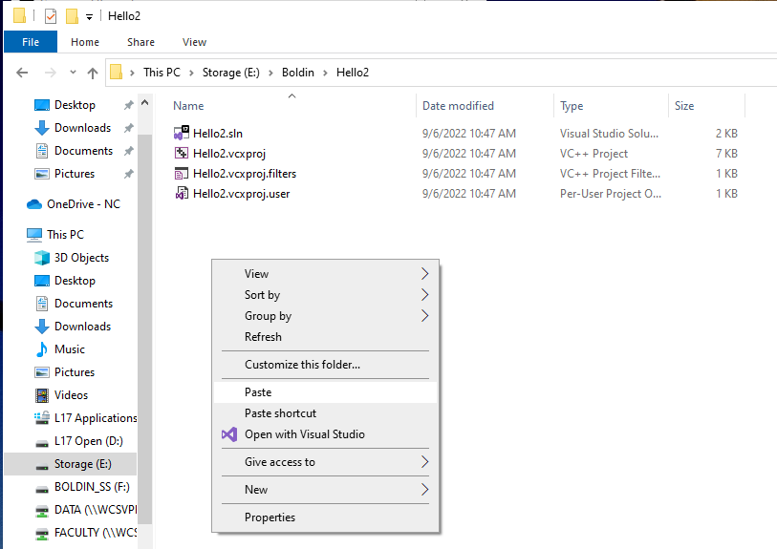
Using code from a previous project
Second, go to the second, newer project and paste the .c file by right-clicking on the empty space.

Slide 59
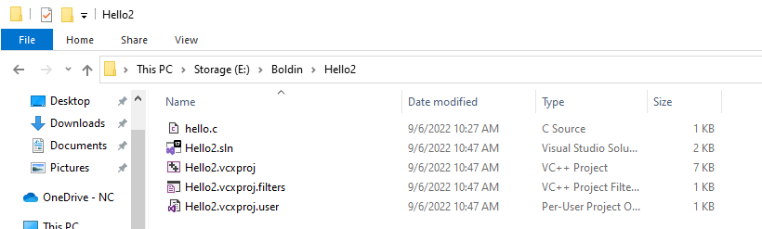
Using code from a previous project
Now you have two copies of the .c file -- the original in the first project and the copy in the second project. You can start to change the copy (NOT THE ORIGINAL!)

Slide 60
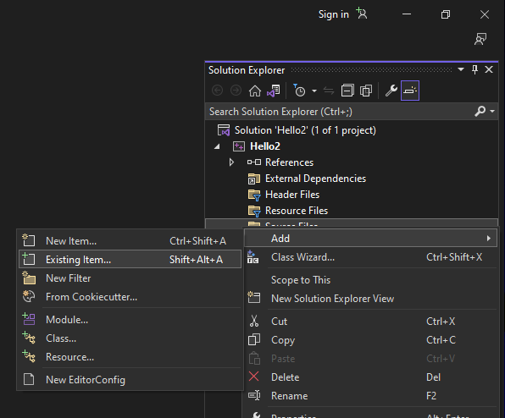
Adding an existing file in VS
Open the second, newer project.
In the Solution Explorer pane, under
Source Files, right-click and select
Add (then) Existing Item…

Slide 61
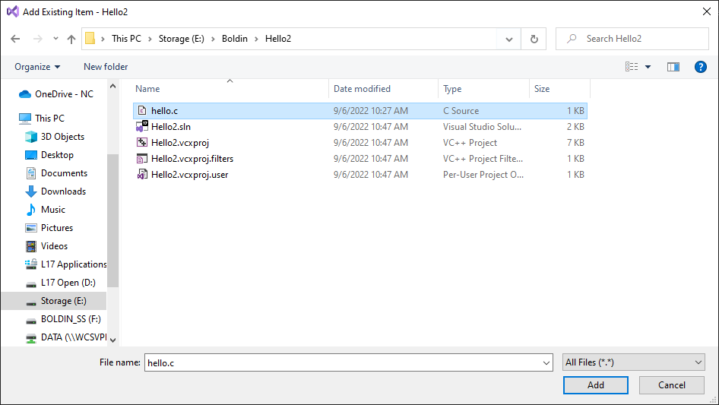
Adding an existing file in VS
Browse to the second project folder
(if necessary -- it should already start there) and select the .c file (that you have copied and pasted.)

Slide 62
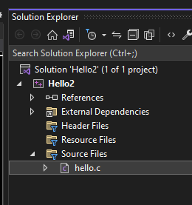
Adding an existing file in VS
Now the copied .c file is part of the second, newer project.
You can click on the filename to open it in the editor (if it doesn't open automatically.)

Slide 63
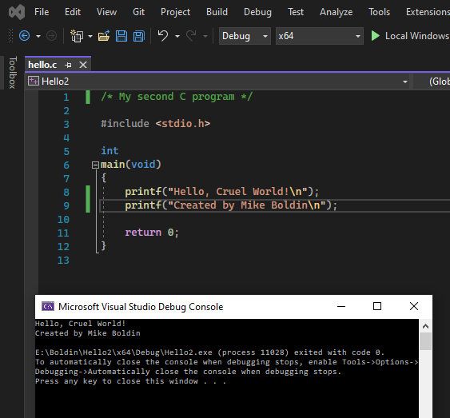
Modify, build and run
Here, I added a new line of
C code (line 9).
I also changed the comment at line 1.
I build the modified program and ran it.
Important!
This technique also
works with just an existing .c file… create the new project and copy the existing .c file to the new project folder.

Slide 64
Summary
Visual Studio 2022 Guide

Slide 65
Creating a new VS2022 project for a CTEC1332 program in L117
Create your own folder on drive E:.
Download an existing .c file to your new folder (or copy it from your USB drive or One Drive NC.)

Slide 66
Creating a new VS2022 project for a CTEC1332 program in L117
Open Visual Studio 2022 and create a new Empty C++ Windows Console project.
  Choose a C++ Windows Console project
  Select Empty Project.
  Set the Location to your folder on drive E:.
  Give the project a Name.
  Place the solution and project in the same folder.

Slide 67
Creating a new VS2022 project for a CTEC1332 program in L117
Using File Explorer (or a Command Prompt), copy and paste the existing .c file in your new project folder. Or go to the course web site, and download template.c.
In VS, add the copied and pasted .c file to your new project.
Add/modify C code.

Slide 68
Creating a new VS2022 project for a CTEC1332 program in L117
Build and run your program.
If there are errors, correct them and repeat step 7.
If the program doesn't work the way you want, repeat steps 6 and 7…
THIS IS THE HARD PART!

Slide 69
Creating a new VS2022 project for a CTEC1332 program in L117
Clean your project.
Close the solution.
Make an archive/backup of your project. Keep the 3-2-1 rule in mind.
VERIFY THAT BACKUPS HAVE BEEN MADE!

Slide 70
Creating a new VS2022 project for a CTEC1332 program in L117
When you are ready to leave, make sure that you have done step 12, and delete your folder from drive E. YOU ARE RESPONSIBLE FOR THIS!!!

