Slide 1
Programming in C (Part 1)
CTEC1332 Software Engineering Practices
Version 1.2; Last Modified: 2020-09-02

Slide 2
“Learning a programming language is like climbing a glass mountain”
There is so much to learn before you can do anything useful
C Programming 1

Slide 3
“Learning a programming language is like learning any new language”
You have to start with the fundamentals … and then move on from there.
C Programming 1

Slide 4
C
C is a general-purpose, procedural computer programming language.
Originally developed at Bell Labs by Dennis Ritchie around 1972
It supports structured programming, variable scope, and recursion, with a static type system.
Applications include operating systems and various application software for computer architectures that range from supercomputers to PLCs and embedded systems.
https://en.wikipedia.org/wiki/C_(programming_language)
C Programming 1

Slide 5
C Versions
Year | Version | Reference
1978 | K&R C | The C Programming Language
1989 | ANSI C/C89 | The C Programming Language, 2nd ed. ANSI X3.159-1989
1990 | ISO C/C90 | ISO/IEC 9899:1990
1999 | C99 (C9X) | ISO/IEC 9899:1999
2011 | C11 (C1X) | ISO/IEC 9899:2011
2018 | C18 (C17) | ISO/IEC 9899:2018
2021? | C2x | T.B.A.
In CTEC1332, CTEC1334 and CTEC1432, our compiler toolchains (as of 2020) have full support for C89/C90 and partial support for C99, so we will focus on those versions.
C Programming 1

Slide 6
Hello, Cruel World!
/* Hello.c */
#include <stdio.h>
int main()
{
printf("Hello, Cruel World!\n");
return 0;
}
C Programming 1

Slide 7
Deconstructing “Hello, Cruel World!”
Comment – Begins with /* and ends with */
/* Hello.c */
#include <stdio.h>
int main()
{
printf("Hello, Cruel World!\n");
return 0;
}
Preprocessor Directive #include -- Read the contents of another file #define – Create a constant or macro #pragma – Set platform-specific information
"main" is a function returning an integer value -- int is a C reserved word and data type; main is also the program entry point
Statement Function call of a library function ("printf"); uses a string literal as the function argument.
Return statement exits the function
A function consists of a declaration/prototype and a definition/ body – one or more statements enclosed in braces and indented.
C Programming 1

Slide 8
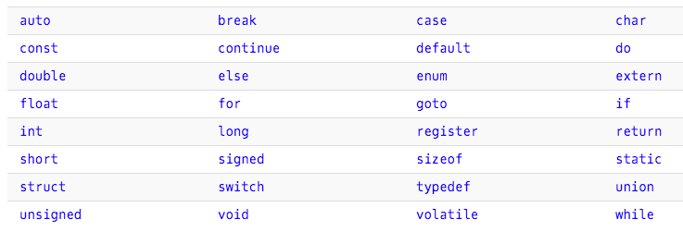
Reserved Words
https://www.programiz.com/c-programming/list-all-keywords-c-language
C Programming 1

Slide 9
Elements of Style
Your code must be first and foremost CORRECT -- i.e., it produces accurate results and output.
Your code must also be MAINTAINABLE -- that is, you or someone else should be able to repair/improve/rewrite/correct it easily.
C Programming 1

Slide 10
Maintainability
One way to achieve this is to use a consistent programming style in each of your programs.
Some issues are purely “religious”, i.e., personal preference.
Whichever style you use, the key is consistency! Pick your own style and stick with it!
C Programming 1

Slide 11
Naming
Use meaningful, self-documenting names for all variables, constants, and functions.
Declare one variable or constant at a time.
Use a comment for each variable to explain its use and units, if applicable.
For example, double Vfwd ; /* diode forward voltage in volts */
C Programming 1

Slide 12
Naming
Names can consist of a combination of lower-case and upper-case letters, digits, and underscores (_)
Names are case-sensitive
Do not begin a name with an underscore
C Programming 1

Slide 13
Naming
Sometimes, simple variable names are OK. For example, int i ; // loop counter
C Programming 1

Slide 14
Spacing
Use both horizontal (spaces, tabs) and vertical (blank lines) spacing in your code.
Saving disk space has not been a concern since the 1980’s!
Makes your code more readable, both on screen and on paper, for you and for others!
C Programming 1

Slide 15
Comments
Comments ideally explain why you made a particular decision when coding
Traditional block comments begin with a /* and end with */, and may span multiple lines
C++-style inline comments begin with a // and continue to the end of the same line
C Programming 1

Slide 16
Comments
Comments are not part of the code
/* This is a block comment (on one line) */
/* * This is a block comment * (on multiple lines) */
sum += number ; // This is an inline comment
C Programming 1

Slide 17
Program Comment Block
Includes a summary of what the program does
Contains the programmer’s (or programmers’) name(s)
May contain a revision history, listing “program maintenance activities”
C Programming 1

Slide 18
Program Comment Block Example
/* * Calculate a simple voltage divider circuit
*
* Mike Boldin, Niagara College Canada
* <mboldin@niagaracollege.ca>
*
* Modification History:
* --------------------
* 2014.06.10 Created
* 2014.06.12 Corrected number of dec. places
* 2018.05.09 Corrected email address
* 2019.01.03 Ported back to C (LOL) */
C Programming 1

