Slide 1

C Variables, Values and Expressions
CTEC1332 Software Engineering Practices
Version 1.4; Last Modified: 2020-09-22

Slide 2
C Syntax
C code is made up of a series of statements, each of which is terminated with a semicolon.
One statement per line... in general.
Whitespace – spaces, carriage returns, and/or tab characters – is ignored by the compiler.
Whitespace, including indentation, makes the code more readable by programmers.
C Programming, Part 2

Slide 3
C Syntax
C is a block-structured language, meaning statements are part of a block of code.
These blocks, which are delimited with curly brackets – {and }, may contain any number of statements, or none at all.
Note that the curly bracket characters do not need accompanying semicolons.
A very important point about C code is that it is case sensitive.
C Programming, Part 2

Slide 4
C Comments
A comment is not, strictly speaking, C code at all, but it happily cohabits with it.
Comments are self-explanatory: They enable you to add descriptive text to your code—in plain English (or French, German, and so on)—which is ignored by the compiler.
/* This is a comment */
C Programming, Part 2

Slide 5
C Comments
/*
* This, too, is a comment
*/
/*********************************
* Comments can span multiple
* lines
********************************/
C Programming, Part 2

Slide 6
Variables
A variable refers to a unit of computer memory.
Variables store data.
To use variables, you have to declare them.
You have to provide both a name and a type.
C syntax for declaring variables merely specifies the type and variable name:
type name;
C Programming, Part 2

Slide 7
Variables
You should also provide a comment for each variable, explaining the meaning or purpose of that variable:
type name; /* comment */
Each variable must also (eventually) be assigned a value.
  This is also known as initializing a variable.
C Programming, Part 2

Slide 8
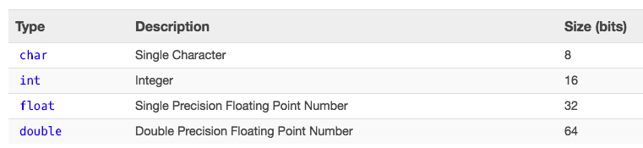
Simple Types
In this course, we need only char, int, and double.
C Programming, Part 2

Slide 9
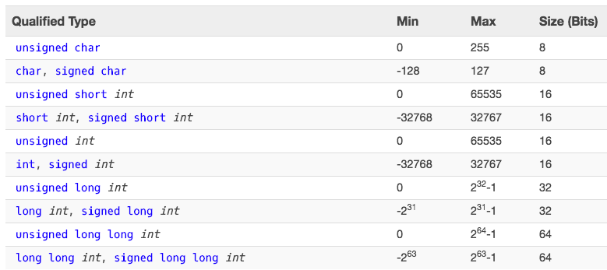
Modified Integer Types
Important! On some platforms int is the same size as short;
on other platforms, int is the same size as long.
C Programming, Part 2

Slide 10
Variable Assignment
name = literal ;
name = expression ;
where:
  name is a variable name
  = is called the assignment operator
  literal is a number, character, or string (text in “quotes”)
  expression is simple code that calculates or generates a value
C Programming, Part 2

Slide 11
Variable Naming
The basic variable naming rules are as follows:
  The first character of a variable name must be either a letter (recommended) or an underscore character (_ -- not recommended.)
  Subsequent characters may be letters, underscore characters, or numbers.
A variable name cannot be a C keyword
  Many IDEs colour keywords in a unique colour, such as blue.
Variable names are case sensitive.
C Programming, Part 2

Slide 12
Constants
Constants use the C preprocessor to replace "magic numbers" with meaningful names in code.
To create a constant:
#define CONSTANT value
where:
  CONSTANT is the name of the constant – named in all uppercase letters and underscores (for readability)
  value is the number (literal, or via an expression) that constant represents.
For example, #define MV_PER_V 1000
C Programming, Part 2

Slide 13
Expressions
You can use operators to manipulate variables.
By combining operators with variables and literal values (together referred to as operands when used with operators), you can create expressions, which are the basic building blocks of computation.
C Programming, Part 2

Slide 14
Operators
Operators can be roughly classified into three categories:
  Unary — act on single operands
  Binary — act on two operands
  Ternary — act on three operands
In C, there is only one ternary operator: ? :
(refer to the unit on Selection for details…)
C Programming, Part 2

Slide 15
Mathematical Operators
C Programming, Part 2

Slide 16
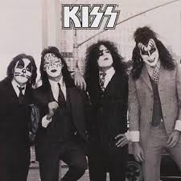
Mathematical Operators
Originally: var1 = ++var2; etc.
Important! Unless you are intimately familiar with operator precedence rules, do not combine these operators in expressions with other mathematical operators:
(Use the KISS principle)
C Programming, Part 2

Slide 17
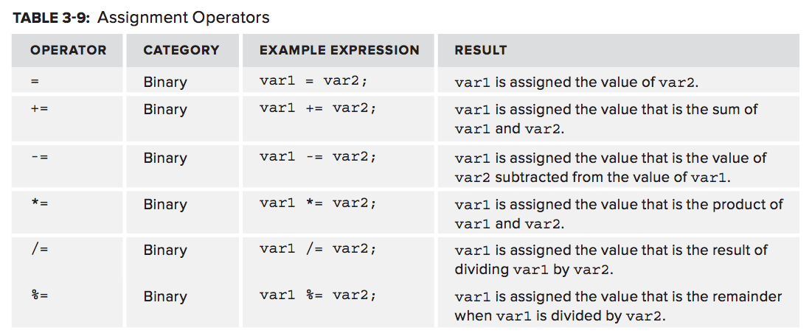
Assignment Operators
C Programming, Part 2

Slide 18
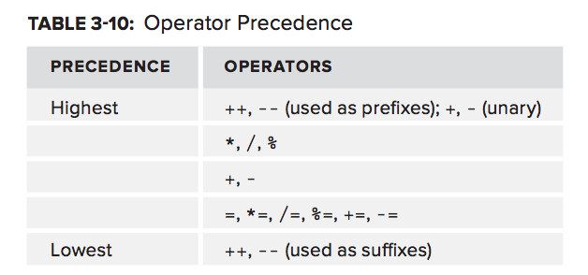
Operator Precedence
NOTE: You can use parentheses (brackets) to override this precedence order.
See http://microchipdeveloper.com/tls2101:precedence for the complete list.
C Programming, Part 2

