Slide 1

The Art and Science of
Problem Solving
CTEC1332 Software Engineering Practices
Version 1.2; Last Modified: 2020-08-11

Slide 2
Problem Solving
You must be able to solve problems in order to succeed in academics or in the real world.
Problem-solving ability is a combination of art and science.
In the real world, the process is more difficult because problem descriptions are often incomplete, imprecise, or ambiguous.
Problem Solving

Slide 3
Problem Solving
The successful problem solver must be able to ask the right questions in order to clarify the problem and obtain any information that is missing from the problem statement.
Next the problem solver must analyze the problem and attempt to extract its essential features, identifying what is provided (the problem inputs) and what is required (the problem outputs).
Problem Solving

Slide 4
Problem Solving
The problem solver must also be able to determine whether any constraints or simplifying assumptions can be applied to facilitate the problem solution.
Often, we cannot solve the general case of a problem; we must make some realistic assumptions that limit or constrain the problem so that it can be solved.
Problem Solving

Slide 5
The Engineering and Scientific Method
CTEC1332 Problem Solving
Problem Solving

Slide 6
1. Recognize and understand the problem.
You must study the problem carefully, eliminating aspects that are unimportant and zeroing in on the root problem.
Problem Solving

Slide 7
2. Accumulate facts.
Get all the relevant physical facts, such as sizes, temperatures, voltages, weights, and costs.
Problem Solving

Slide 8
3. Select the appropriate theory or principle.
Pick the theories or scientific principles that apply to the problem solution.
Problem Solving

Slide 9
4. Make necessary assumptions.
Perfect solutions to many real problems do not exist. You need to make simplifications if you want to solve problems.
Make sure that your simplifications do not significantly affect the accuracy of the problem.
Problem Solving

Slide 10
5. Solve the problem.
If Steps 3 and 4 result in a set of mathematical equations (called a model), you can solve the problem by solving the equations, a trial-and-error solution, or some form of graphical solution.
Problem Solving

Slide 11
6. Verify and check results.
The work is not finished just because a solution has been reached.
The solution has to be checked to ensure that it is mathematically correct and that units have been properly specified.
Problem Solving

Slide 12
Problem Solving
A process in which we go about solving a specific problem.
Before you can problem solve:
  Determine the nature of the problem
  Clearly define the problem
  Decide if you are going to solve the problem
  Start analyzing the problem

Slide 13
Problem Solving Models
Many problem solving models are similar and most include at least four phases:
  Input phase – a problem is identified and an attempt is made to understand the problem;
  Processing phase – alternatives are created and evaluated and a solution is chosen;
  Output phase – planning for and applying the solution;
  Review phase -the solution is evaluated and changes are made if required.

Slide 14
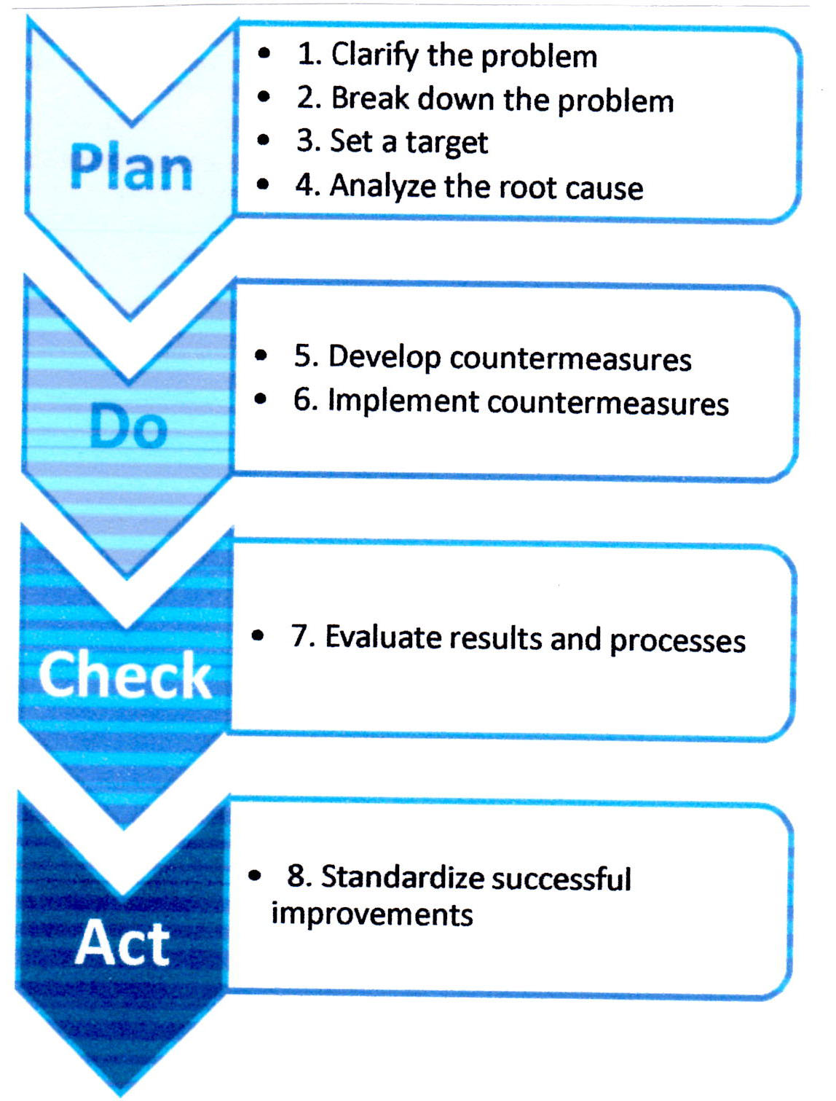
The Eight Steps for Successful
Problem Solving
Based on the Toyota Business Process October 2010
8-Step Problem Solving Model

Slide 15
Computer Systems Problem Solving Model
Identify the problem;
Establish a theory;
Divide and conquer;
Repair the problem, or go back to test another theory;
Test the solution;
Provide feedback to the user.

Slide 16
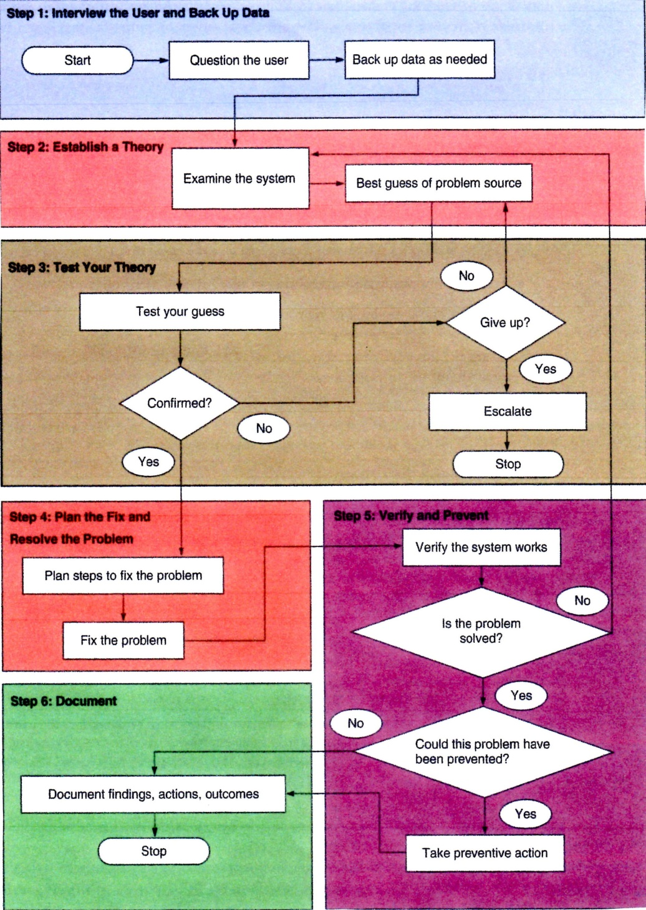
Steps to System Troubleshooting
The following series of steps is important in computer repair to make it easier and quicker to solve the computer problem.

Slide 17
What is "Engineering"?
A discipline based on science to solve practical problems in the service of humanity.
Repeatable and based on professionalism
Understanding technologies; making decisions based on balancing trade-offs
Problem Solving

Slide 18
What is "Software Engineering"?
From Frederick P. Brooks’ The Mythical Man-Month: Essays on Software Engineering...
  how to design and build a set of programs into a system
  how to design and build a program or a system into a robust, tested, documented, supported product
  how to maintain intellectual control over complexity in large doses
Problem Solving

Slide 19
What is "Software Engineering"?
means developing software that has certain qualities
  meets its stated requirements
  is useful and useable
  can be created with predictable schedule, budget, performance, reliability and robustness
Problem Solving

Slide 20
What is "Software Engineering"?
It's not just programming!
  includes requirements gathering, design, modeling, programming, quality assurance (QA), deployment, and maintenance
also has non-engineering concerns
  economic concerns
  These are not engineering concerns, but legitimate concerns none the less
Problem Solving

Slide 21
Software Engineering
Systems designers in the computer industry have found that the engineering and scientific method of problem solving can be adapted to the development of reliable software systems as well.
This approach is called software engineering.
Problem Solving

Slide 22
1. Requirements Specification.
we must fully understand the problem
gather facts about the problem environment
make any necessary assumptions that pin down the problem
Problem Solving

Slide 23
2. Analysis.
identify problem inputs and outputs
look for appropriate theories or principles
list any relevant formulas or relationships
Problem Solving

Slide 24
3. Design.
"solve the problem”
the human figures out a way to solve the problem and writes an algorithm that lists major subproblems
using the "divide and conquer" technique, solves each subproblem separately
keep refining each subproblem until there is a clear, complete solution.
Problem Solving

Slide 25
4. Implementation.
translate the algorithm into code, e.g., C#
now the computer can solve the problem too
data become constants and variables
the refined algorithm becomes statements
Problem Solving

Slide 26
5. Verification and Testing.
as we test and debug the program, we first remove all obvious errors
then we run the program several times with a variety of test data to ensure that the program works properly
check the program outputs against computations
Problem Solving

Slide 27
Failure is Part of the Process!
We shouldn't jump to the conclusion that if we follow these steps, we are guaranteed a correct solution the first time, every time.
The first (also the second, the third, or the twentieth) attempt at a solution may be wrong!
The outstanding problem solver is not discouraged by initial failure.
Failures tell you what does not work.
Problem Solving

Slide 28
Understanding the Problem
The ability to listen carefully is an important skill in human communication.
Often, we are too busy thinking of what our response will be to really hear what another person is saying.
This can lead to a lack of understanding between a speaker and a listener.
Problem Solving

Slide 29
Understanding the Problem
Many of us suffer from a similar difficulty when we attempt to solve problems that are presented in either verbal or written form.
We do not pay close attention to the problem statement to determine what is really being asked; consequently, either we are unable to solve the stated problem or we reach an incorrect solution because we solve the wrong problem.
Problem Solving

Slide 30
Understanding the Problem
You should analyze a problem statement carefully before attempting to solve it.
The first time you read a problem, you should get a general idea of what is being asked.
Problem Solving

Slide 31
Understanding the Problem
The second time you read it, you should try to answer the following questions:
    What information should the solution provide?
What data do I have to work with?
Problem Solving

Slide 32
Understanding the Problem
The answer to the first question will tell you the problem outputs.
The answer to the second question will tell you the problem inputs.
Problem Solving

